Slide 1
TEAM FOXTROT
SAFEPAWS
FINAL DESIGN REVIEW
ECE - Capstone Design 1

Slide 2




Overview
Introduction
User Journey
Competitive Advantage
Design Overview
Subsystems
Future Work
Conclusion
Questions?
References

Slide 3




Our
Team
Nathan Phan
Victor Gonzalez
Terry Jenkins
Team Lead / Sensors
Communications
Data Systems
SafePaws

Slide 4



Our
Team
Clayton Lott
DeArirreis Vance
Vuk Marojevic
Power Systems
Software
Faculty Advisor
SafePaws

Slide 5


SafePaws
The Problem
Problem 01
Problem 02
Problem 03
Owners can lead busy lives leaving limited time for continuous monitoring of their dogs' health.
Veterinary visits can be time-consuming, costly, and may not offer timely insights into a pet's health.
Current pet health monitoring products on the market are complex and expensive, limiting accessibility for some owners.

Slide 6

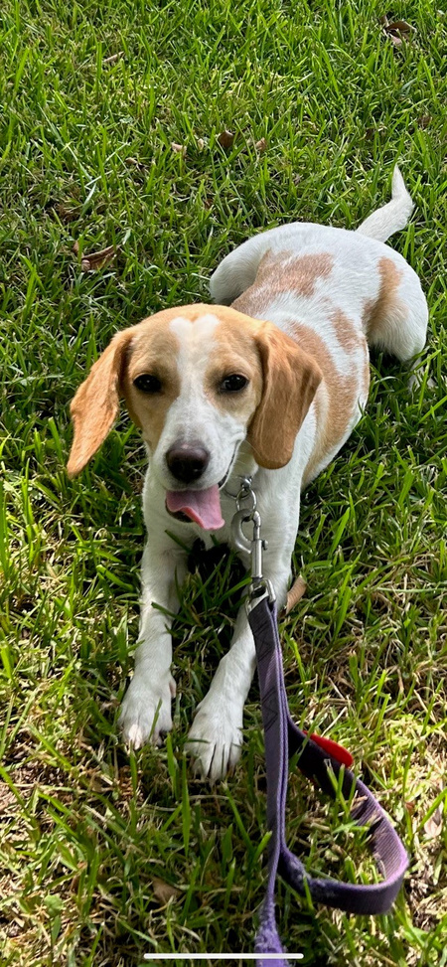
2
SafePaws
Our Solution
Continuous & Convenient Monitoring
Pet
Comfort
Design
Less Expensive
than Competitors
Notes:
user experience - cost, ease of use
functionality - alerts, continuous, app
performance - data accurate, battery life

Slide 7


Competition
DogLeggs [1]
Cost
Specialized Use
Limited Connectivity
PetPace [2]
Expensive Initial Cost
Subscription to Premium Features
SafePaws

Slide 8
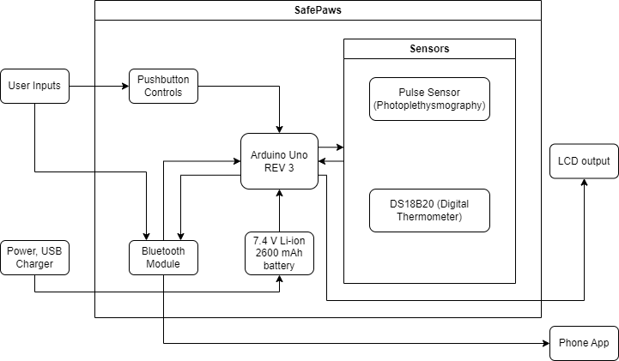
4
SafePaws
Design Overview

Slide 9




5
01
02
03
04
Subsystems
SafePaws

Slide 10
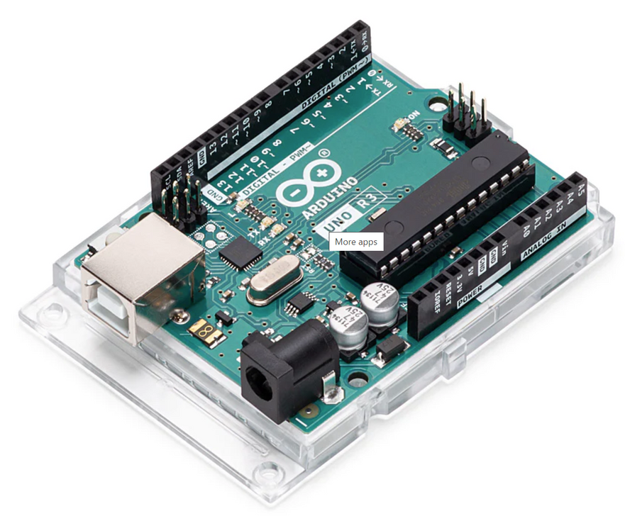
SafePaws
Controller
Arduino Uno REV3
Advantages: [3]
Low-power requirement
Support for a wide range of peripherals
SD card read/write
WiFI/Bluetooth
Digital/analog sensor support
Well-supported software library
SD-FATLIB (FAT16/FAT32 file systems)
Arduino BLE (Bluetooth), ConnectionHandler (WiFI)
Alternatives considered:
Basys Board
Raspberry Pi
Arduino Uno REV3
https://store.arduino.cc/products/arduino-uno-rev3

Slide 11
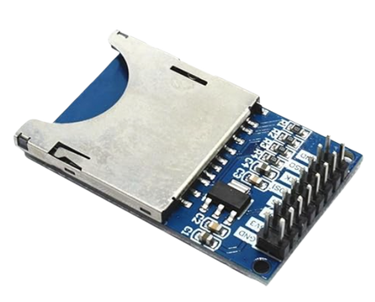
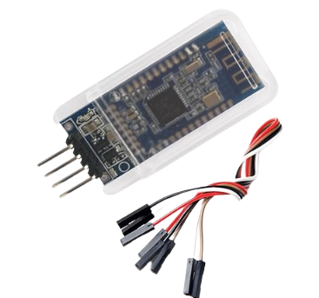
SafePaws
Communications
File Storage & Wireless Connectivity
SD Card
Bluetooth
Zittop SD Card Read/Write Module
DSD TECH HM-10 M Bluetooth 4.0 LE
100GB Read/Write Speed Support
4-wire connectivity
Bluetooth 4.0 support
4-wire connectivity
Notes:
not completed

Slide 12
SafePaws
Sensors
Pulse Sensor (Photoplethysmogram)
PPG utilizes a light-emitting diode to detect changes in blood volume. [4]
The vest uses 2 Pulse Sensors for more accurate readings.
Ease of use.
DS18B20 (Digital Thermometer)
DS18B20 uses a feature called the one-wire interface. [5]
This thermometer has a wider temperature range than alternatives.
This sensor allows for more accurate readings.
Notes:
ease of use?

Slide 13
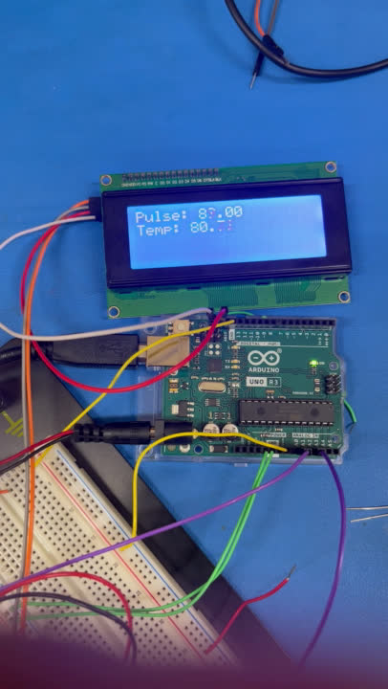
SafePaws
Sensors
Notes:
slide for sensor demonstration

Slide 14

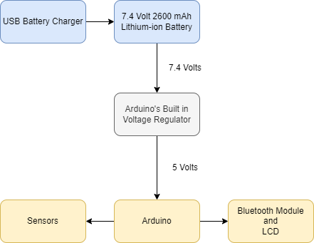
Power
7.4V 2600mAh lithium-ion battery
Arduino steps down usage to 5-volt
37 hours of usable battery life (goal of 24 hours)
Removable battery
USB rechargeable
SafePaws

Slide 15
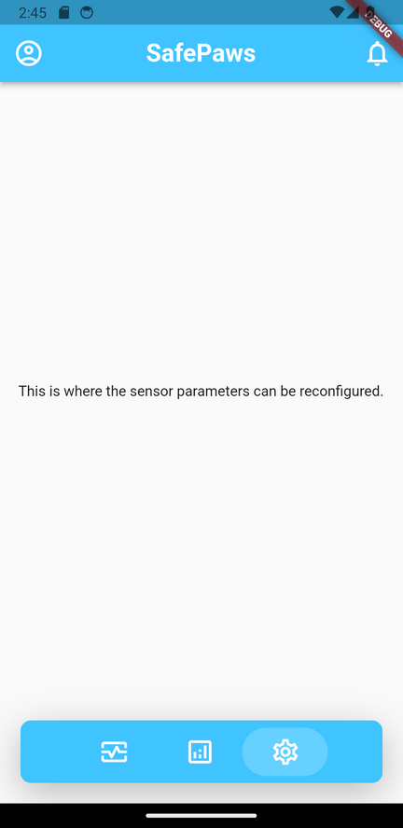
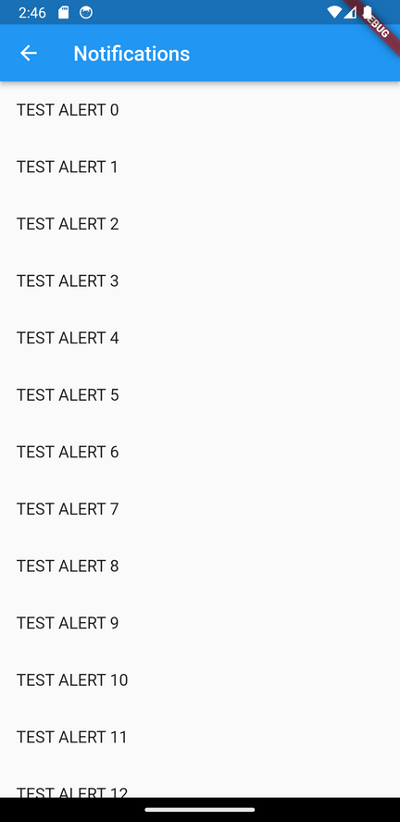

Mobile Application
Easy to Use
Modern Design
Cross-Platform Compatibility
User Friendly
SafePaws

Slide 16
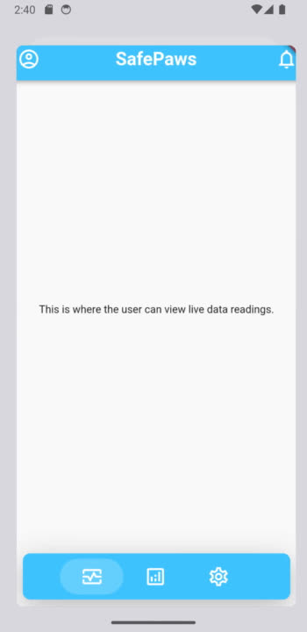
Snapshot
SafePaws
Notes:
slide for app demonstration

Slide 17

SafePaws
Upcoming
Implementation into vest
Right now the subsystems are configured loosely; so the next step is to integrate them into the vest in such a way as to meet our constraints.
Removal of LCD
The LCD is only there for testing purposes; it will not be integrated into the final design as the needed information will be transmitted to the mobile app.
App Development
The application software is still being developed to reach launch-ready.

Slide 18
Reflections
Challenges
Teamwork
Design
Limitations
Time
Money
Lack of knowledge
Lessons Learned
Coding
Oral Communication
Hardware integration

Slide 19
References
[1] “Dog Leg Wraps, Braces, & Carpal Support | Hygroma Treatment Solutions,” dogleggs.com. https://www.dogleggs.com/ (accessed Sep. 01, 2023).
{2] “How it works - PetPace,” PetPace.com, https://petpace.com/how-it-works/ (accessed Sep. 01, 2023).
[3] “Arduino Uno R3 Specification Sheet.” Arduino Documentation. https://docs.arduino.cc/hardware/uno-rev3 (accessed Oct. 20, 2023).
[4] “In-Depth: Detect, Measure & Plot Heart Rate Using Pulse Sensor & Arduino,”
LastMinuteEngineers.com. https://lastminuteengineers.com/pulse-sensor-arduino-tutorial/ (accessed Nov 8, 2023)
[5] “Waterproof 1-Wire DS18B20 Digital Temperature Sensor,” Adafruit.com.
https://www.adafruit.com/product/381?gclid=CjwKCAjws9ipBhB1EiwAccEi1I_Cpjkz6gxzXgaTveIUXc
OG1HRZNsbkSlXBfyg8ZbmgEaWvQ2WrZRoCuzIQAvD_BwE (accessed Nov 8, 2023).
Notes:
references not completed

